Slide 1
Kubernetes

Slide 2
Previous Lecture summary:
Containerization is a type of virtualization at the application level, which allows for multiple isolated user space instances on a single kernel. These instances are called containers.
Containers provide a standard method of packaging an application's code, runtime, system tools, system libraries, and configurations into one instance. Containers share one kernel (operating system), which is installed on the hardware.
Docker is a software platform that allows you to build, test, and deploy applications quickly, packaging software into standardized units called containers.

Slide 3
Contents
Container Orchestration
Orchestration Tools
Kubernetes
Kubernetes Architecture
Kubernetes Features
Docker Vs Kubernetes

Slide 4
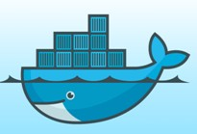

Container Orchestration
Container orchestration automates the provisioning, scaling, deployment, availability, and lifecycle management of containers.
Container orchestration is a tool that use to automate the Containers management.

Slide 5
Provisioning
Provisioning is the process of setting up IT infrastructure. It can also refer to the steps required to manage access to data and resources, and make them available to users and systems.
When the term “provisioning” is used, it can mean many different types of provisioning, such as server provisioning, network provisioning, user provisioning, service provisioning, and more.

Slide 6
Scaling
In cloud computing, scaling is the process of adding or removing compute, storage, and network services to meet the demands a workload makes for resources in order to maintain availability and performance as utilization increases.
Scale Up (Vertical Scaling)
  Scaling up is the process of resizing a server (or replacing it with another server) to give it supplemental or fewer CPUs, memory, or network capacity.
Scale Out (Horizontal Scaling)
  Instead of resizing an application to a bigger server, scaling out splits the workload across multiple servers that work in parallel.
Auto-scaling is the process of automatically increasing or decreasing the computational resources delivered to a cloud workload based on need.

Slide 7
Deployment
Software deployment is all of the processes that make a software system available for use.
Cloud deployment is the process of deploying an application through one or more hosting models—software as a service (SaaS), platform as a service (PaaS) and/or infrastructure as a service (IaaS).

Slide 8
Container Orchestration Tools
Some popular open source container orchestration tools include
Kubernetes
Docker Swarm

Slide 9
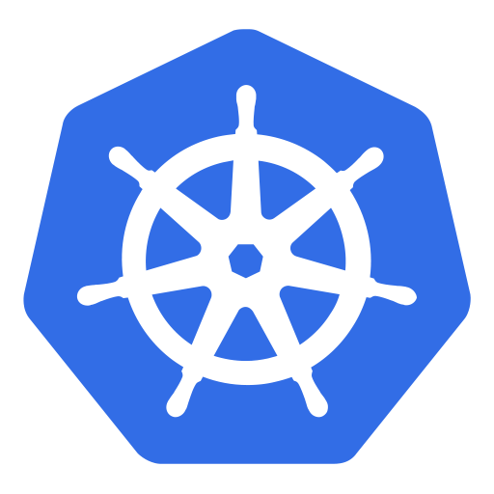
Kubernetes
Kubernetes is an open-source container orchestration tool for automating deployment, scaling, Load-balancing, scheduling the run isolated containers and management of containerized applications.
This platform is designed and developed by Google in 2014 built in GO programming language.
Sport Json or YAML (Ain't Markup Language) YAML is a human-readable data-serialization language.
Kubernetes is also known as 'k8s‘.
The open-source project is hosted by the Cloud Native Computing Foundation (CNCF).

Slide 10
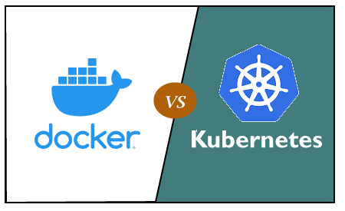
Docker vs. Kubernetes
Difference

Slide 11
Docker vs. Kubernetes (Cont.)
Docker | Kubernetes
Docker is developed by Docker Inc. | Kubernetes is developed by Google.
It was first released in 2013. | It was first released in 2014.
Docker create containers / Images | Kubernetes Create Clusters
Container based technology used to create isolated environment for applications. | It is an infrastructure for managing multiple containers.
Its public cloud service provider is only Azure. | Its public cloud service providers are Google, Azure, and AWS.
It is less customizable. | It is highly customizable.
It is easy to install. | It is complex to install.
It cannot do auto-scaling. | It can do auto-scaling.
It does not provide any dashboard. | It provides a Web UI dashboard.
Its container limit is 95000. | Its container limit is 300000.

Slide 12
Kubernetes Architecture
The architecture of Kubernetes actually follows the client-server architecture.
It consists of two main components:
Master Node (Control Plane)
Slave/worker node

Slide 13
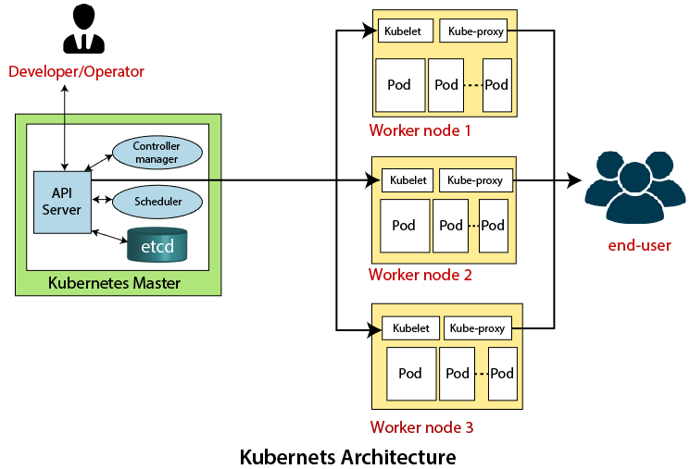
  Kubernetes Architecture

Slide 14
Key Components of Kubernetes
Pod
  It is the smallest and simplest basic unit of the Kubernetes application. This object indicates the processes which are running in the cluster.
Node
  A node is nothing but a single host, which is used to run the virtual or physical machines. A node in the Kubernetes cluster is also known as a minion.
Service
  A service in a Kubernetes is a logical set of pods, which works together. With the help of services, users can easily manage load balancing configurations.

Slide 15
Master Node or Kubernetes Control Plane
The master node in a Kubernetes architecture is used to manage the states of a cluster.
It is actually an entry point for all types of administrative tasks.
In the Kubernetes cluster, more than one master node is present for checking the fault tolerance.

Slide 16
Master Node Components
API Server
  The Kubernetes API server receives the REST commands which are sent by the user. After receiving, it validates the REST requests, process, and then executes them. After the execution of REST commands, the resulting state of a cluster is saved in 'etcd' as a distributed key-value store.
Scheduler
  The scheduler in a master node schedules the tasks to the worker nodes. And, for every worker node, it is used to store the resource usage information.
  In other words, it is a process that is responsible for assigning pods to the available worker nodes.

Slide 17
Master Node Components (Cont.)
Controller Manager
  The Controller manager is also known as a controller. It is a daemon that executes in the non-terminating control loops. The controllers in a master node perform a task and manage the state of the cluster. In the Kubernetes, the controller manager executes the various types of controllers for handling the nodes, endpoints, etc.
ETCD
  It is an open-source, simple, distributed key-value storage.
  It is used to store the cluster data.
  It is a part of a master node which is written in a GO programming language.
  (Linux directory structure: In UNIX, all system configuration files for a single system are contained in a folder called “/etc;” “d” stands for “distributed.”)

Slide 18
Worker/Slave node
The Worker node in a Kubernetes is also known as minions.
A worker node is a physical machine that executes the applications using pods.
It contains all the essential services which allow a user to assign the resources to the scheduled containers.

Slide 19
Worker/Slave components
Kubelet
  This component is an agent service that executes on each worker node in a cluster.
  It ensures that the pods and their containers are running smoothly.
  Every kubelet in each worker node communicates with the master node.
  It also starts, stops, and maintains the containers which are organized into pods directly by the master node.

Slide 20
Worker/Slave components (Cont.)
Kube-proxy
  It is a proxy service of Kubernetes, which is executed simply on each worker node in the cluster.
  The main aim of this component is request forwarding.
  Each node interacts with the Kubernetes services through Kube-proxy.

Slide 21
Worker/Slave components (Cont.)
Pods
  A pod is a combination of one or more containers which logically execute together on nodes. One worker node can easily execute multiple pods.

Slide 22
Features of Kubernetes
Pod:
  It is a deployment unit in Kubernetes with a single Internet protocol address.
Horizontal Scaling:
  It is an important feature in the Kubernetes. This feature uses a HorizontalPodAutoscalar to automatically increase or decrease the number of pods in a deployment, replication controller, replica set, or statful set on the basis of observed CPU utilization.
Automatic Bin Packing:
  Kubernetes helps the user to declare the maximum and minimum resources of computers for their containers.
Service Discovery and load balancing:
  Kubernetes assigns the IP addresses and a Name of DNS for a set of containers, and also balances the load across them.

Slide 23
Features of Kubernetes (Cont.)
Persistent Storage:
  Kubernetes provides an essential feature called 'persistent storage' for storing the data, which cannot be lost after the pod is killed or rescheduled. Kubernetes supports various storage systems for storing the data, such as Google Compute Engine's Persistent Disks (GCE PD) or Amazon Elastic Block Storage (EBS). It also provides the distributed file systems: NFS or GFS.
Self-Healing:
  This feature plays an important role in the concept of Kubernetes. Those containers which are failed during the execution process, Kubernetes restarts them automatically. And, those containers which do not reply to the user-defined health check, it stops them from working automatically.

Slide 24
Features of Kubernetes (Cont.)
Automated rollouts and rollbacks:
  Using the rollouts, Kubernetes distributes the changes and updates to an application or its configuration. If any problem occurs in the system, then this technique rollbacks those changes for you immediately.

Slide 25
Thanks
…?

